Slide 1
MKT 6352 Marketing Web Analytics and Insights
Group No.4 : kxb200050 Kruti Brahmbhatt
rxj210013 Rashi Jain
ssp210003 Sejal Pachpor
mxc200000 Manas Chourey
mxm190116 Madhur Mehta
pxs180103 Pranay Shah

Slide 2



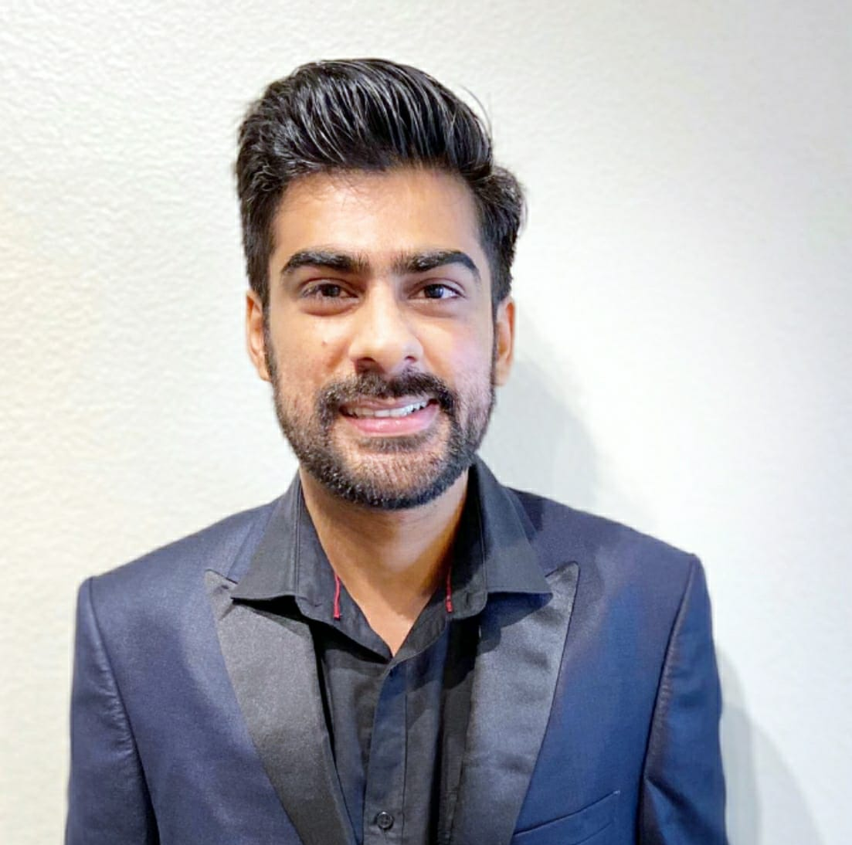
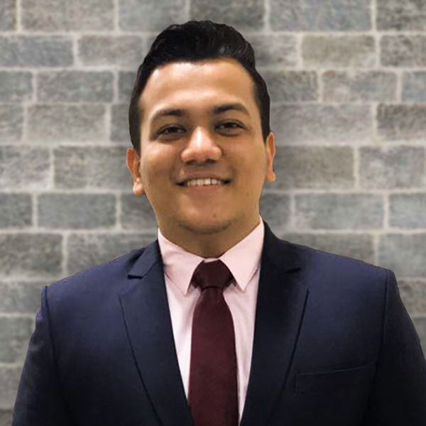

TEAM PRESENTATION
Kruti Brahmbhatt
Manas Chourey
Rashi Jain
Madhur Mehta
Pranay Shah
Sejal Pachpor

Slide 3

Our Company – Walmart

Slide 4
About Walmart
Wal-Mart was founded by Sam Walton in Rogers, Arkansas, in 1962
Walmart is the top ranked Fortune 500 company
They aspire to become a regenerative company – helping to renew people and planet through their business
Every Day Low Price is the cornerstone of Walmart’s strategy their commitment to this is embedded in every action they take

Slide 5
About Walmart
Mission
Helping people around the world save money and live better – anytime and anywhere – in retail stores and through eCommerce
Objective
Walmart aims to provide safe, affordable food and other products to people around the world
Vision
Make every day easier for busy families

Slide 6
Business Objectives
Building loyalty within customers
Increase revenue from visitor conversions
Optimize website for top customer experience

Slide 7
Key Performance Indicator
Conversion
Rate
Bounce
Rate
Revenue

Slide 8
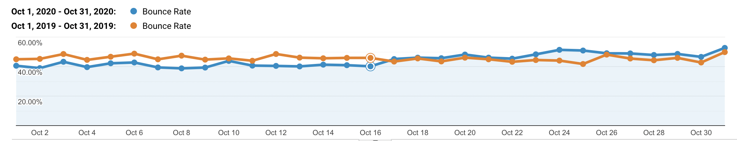
Bounce Rate

Slide 9
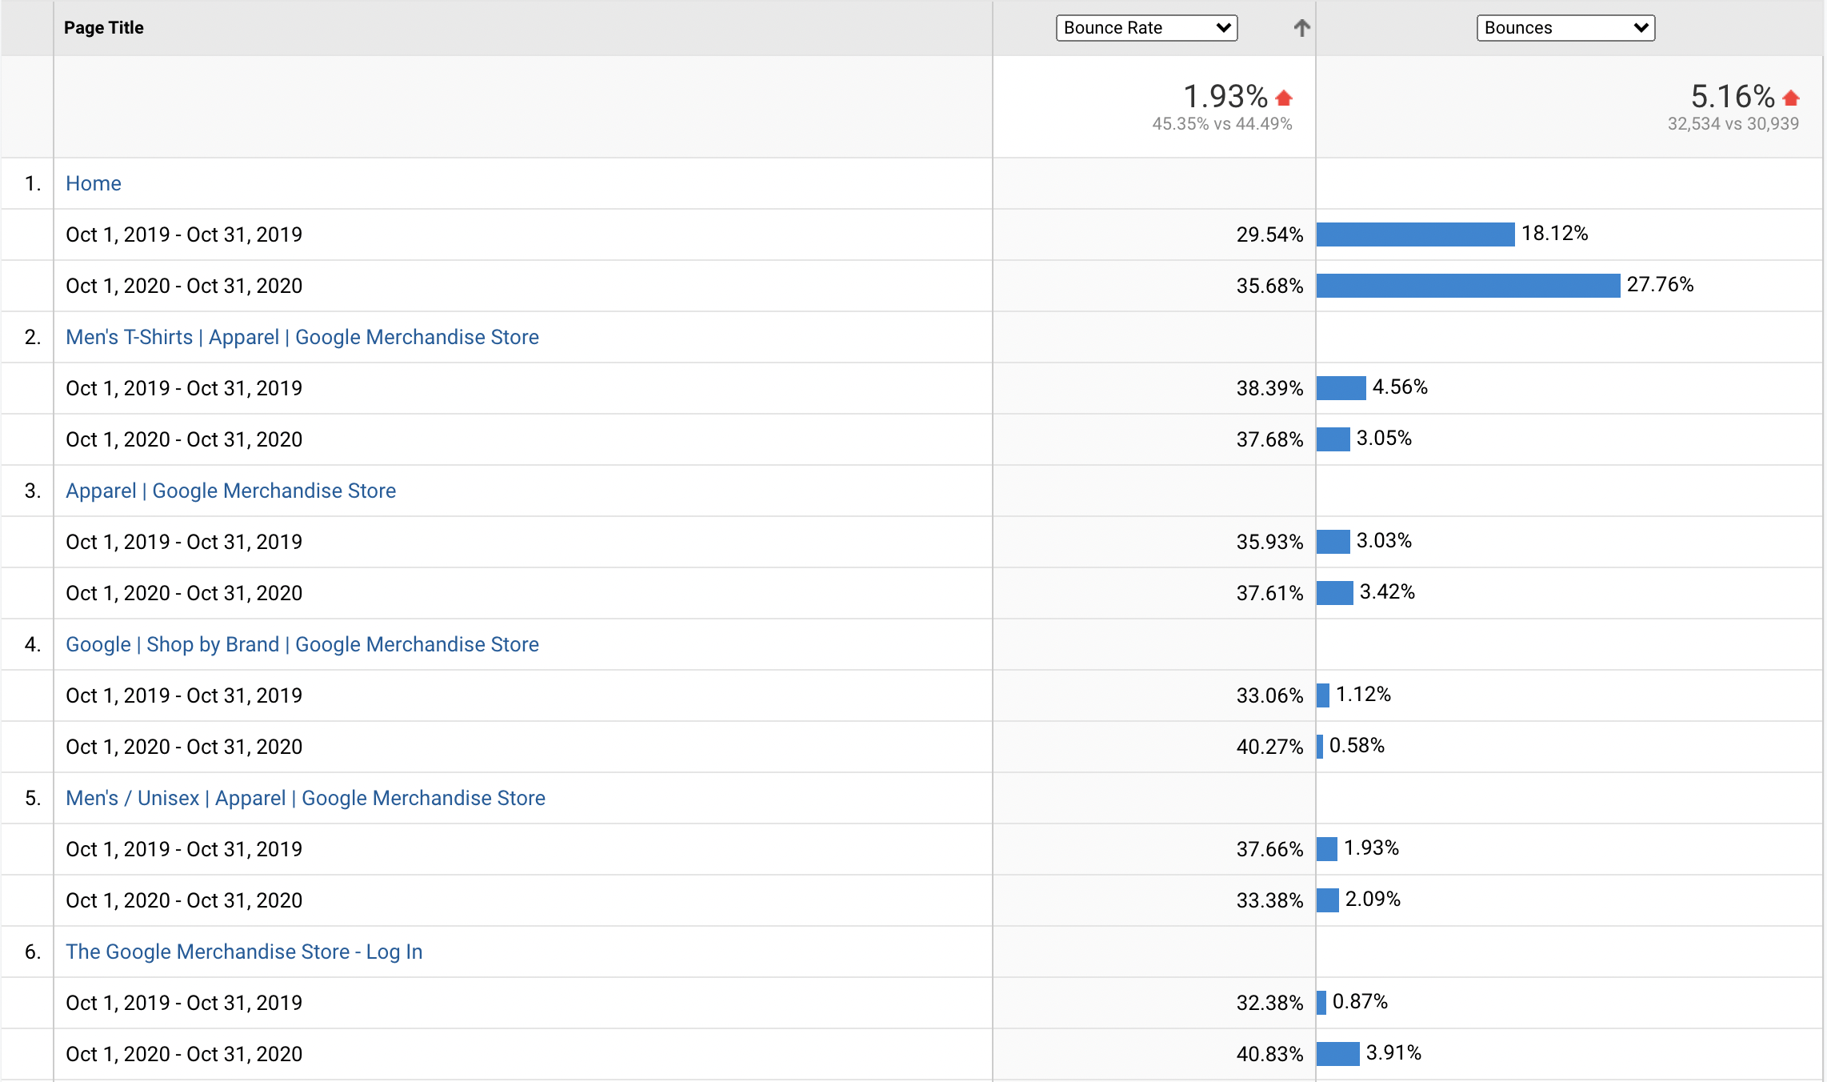
Bounce Rate

Slide 10
OUR RECOMENDATIONS
Website Responsiveness
A/B Testing
Interactive Content
We need to monitor the responsiveness of the website, with evolving technology we need to make sure that we can cater to all the screen sizes, input methods, and devices compatibilities
Consistent A/B testing is also recommended to improve the UX of the website. We can perform A/B test on the targeted pages where we want our bounce rate numbers to improve
Investing in interactive content is also recommended, as when we ask users to take actions this will always lead to exploring and visiting other pages

Slide 11
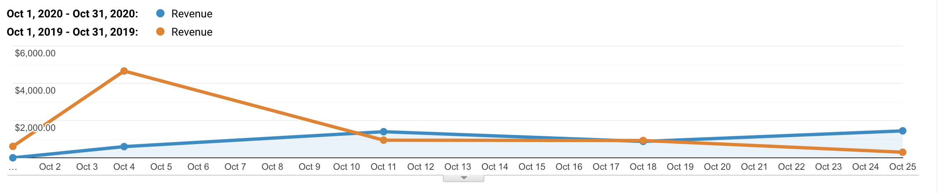
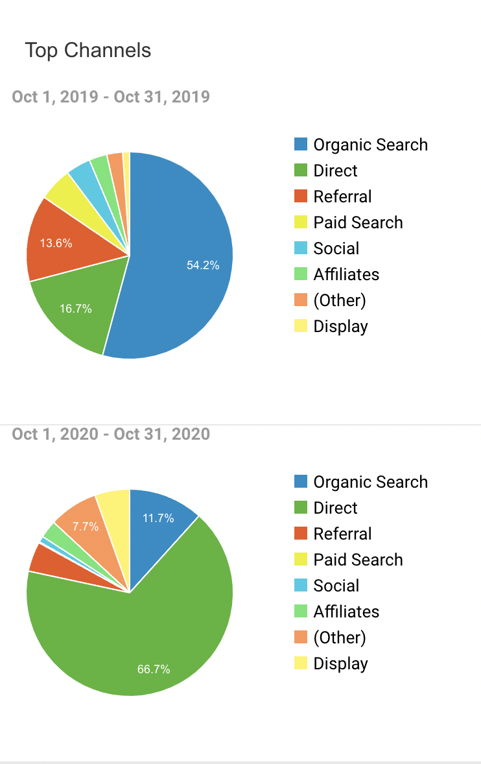
Revenue

Slide 12
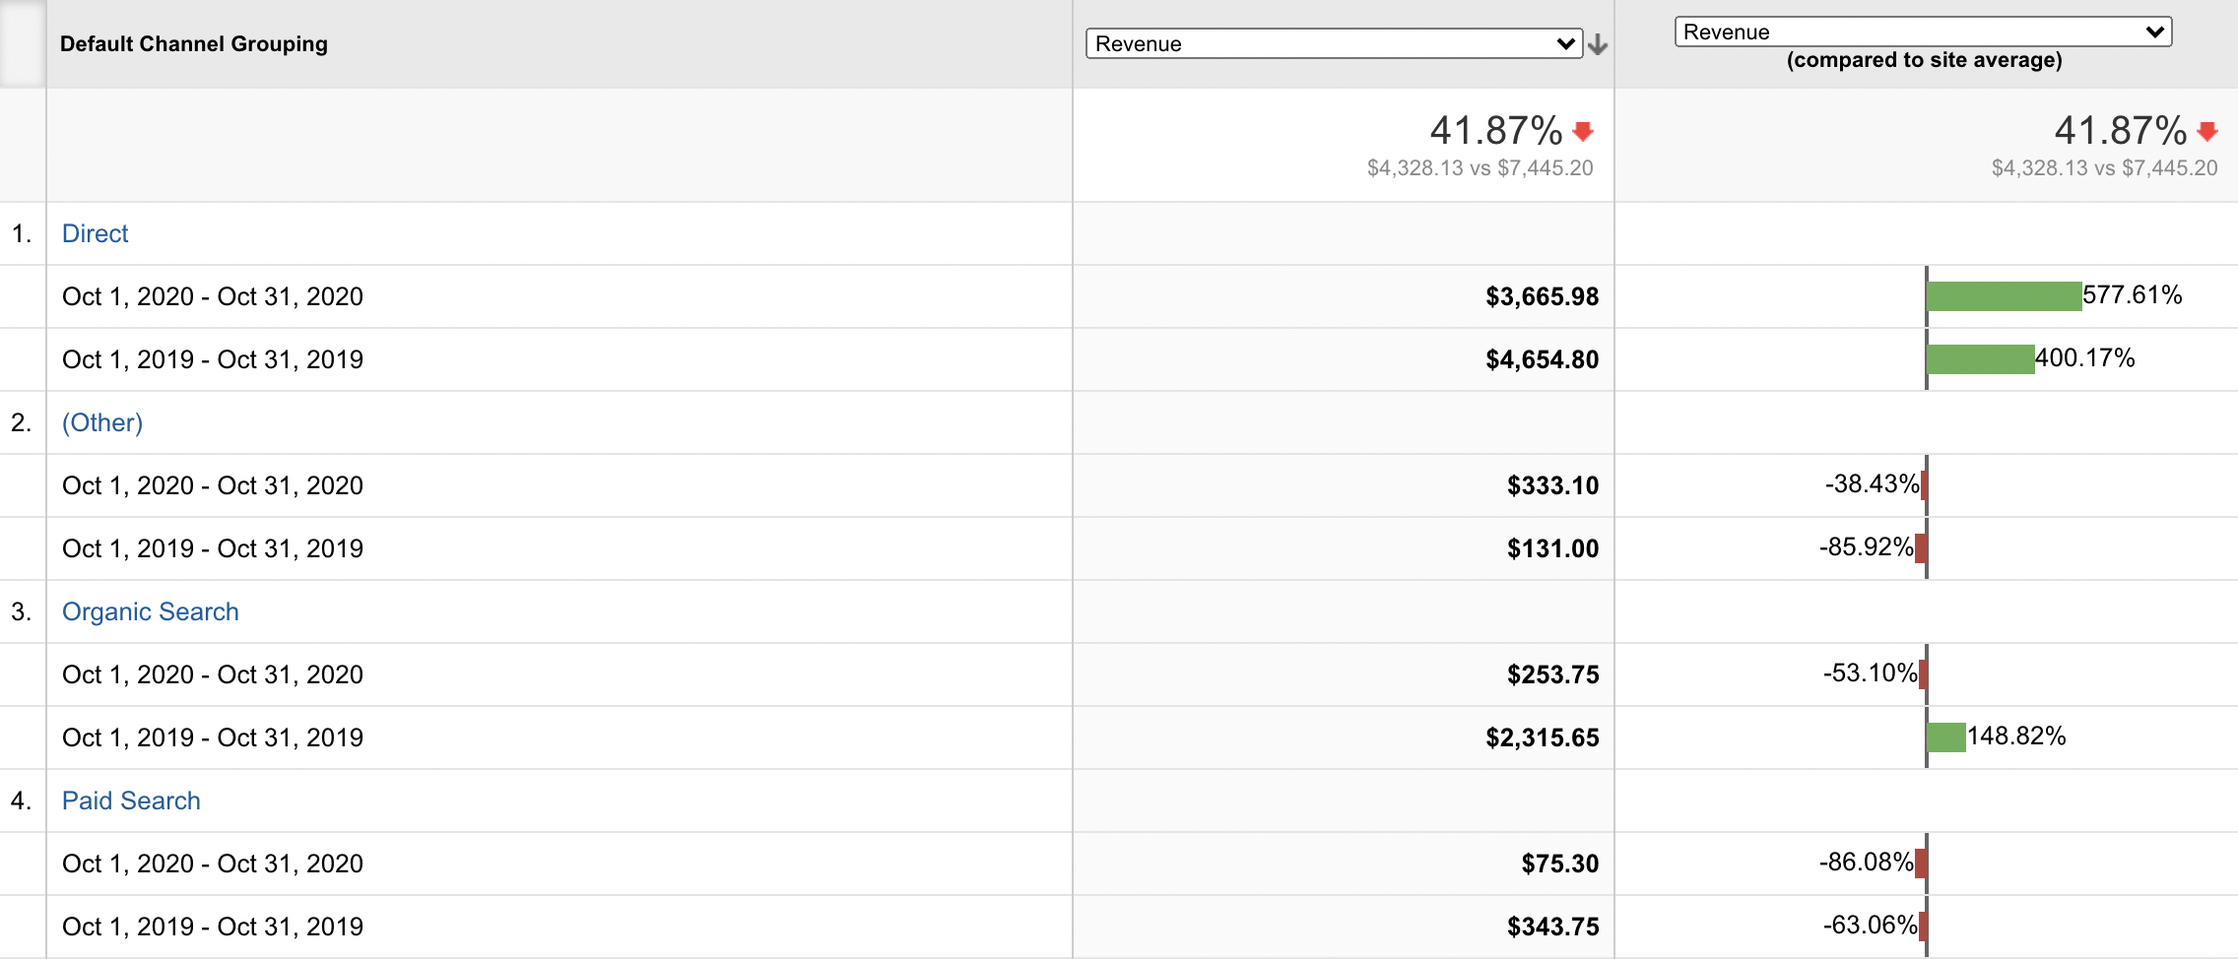
Revenue

Slide 13
OUR RECOMENDATIONS
Marketing Campaigns
Leverage Smart List
Focus on Cross and Up selling
Paid search sessions have not been doing well as compared to direct search, so we
should invest in Marketing campaigns and measure the effectiveness of marketing campaign. We should keep on updating the campaign as per weekly analysis to optimize the revenue
Smart Lists will automatically generate lists of users that are most likely to convert. To improve our remarketing strategy, we should use our Smart Lists on Google Display Network, Google Search Ads, or DoubleClick Bid Manager
Cross-selling and upselling both focus on providing additional value to company’s customers. These two inform customers about some additional product options they may not already know about. This will help us understand what our customers want and then responding with products and offerings and corresponding features that truly meet those needs

Slide 14
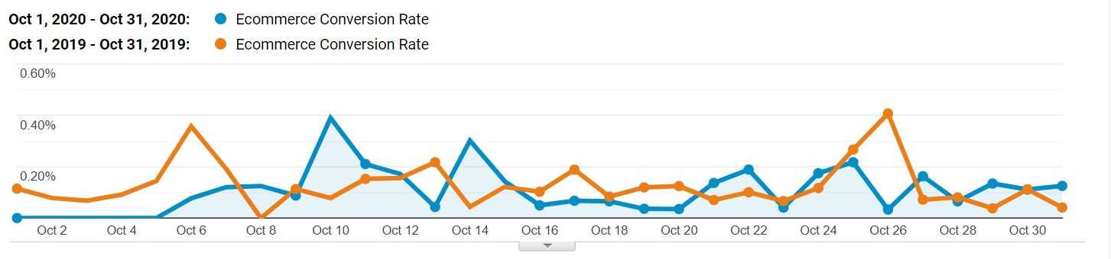
Conversion Rate

Slide 15
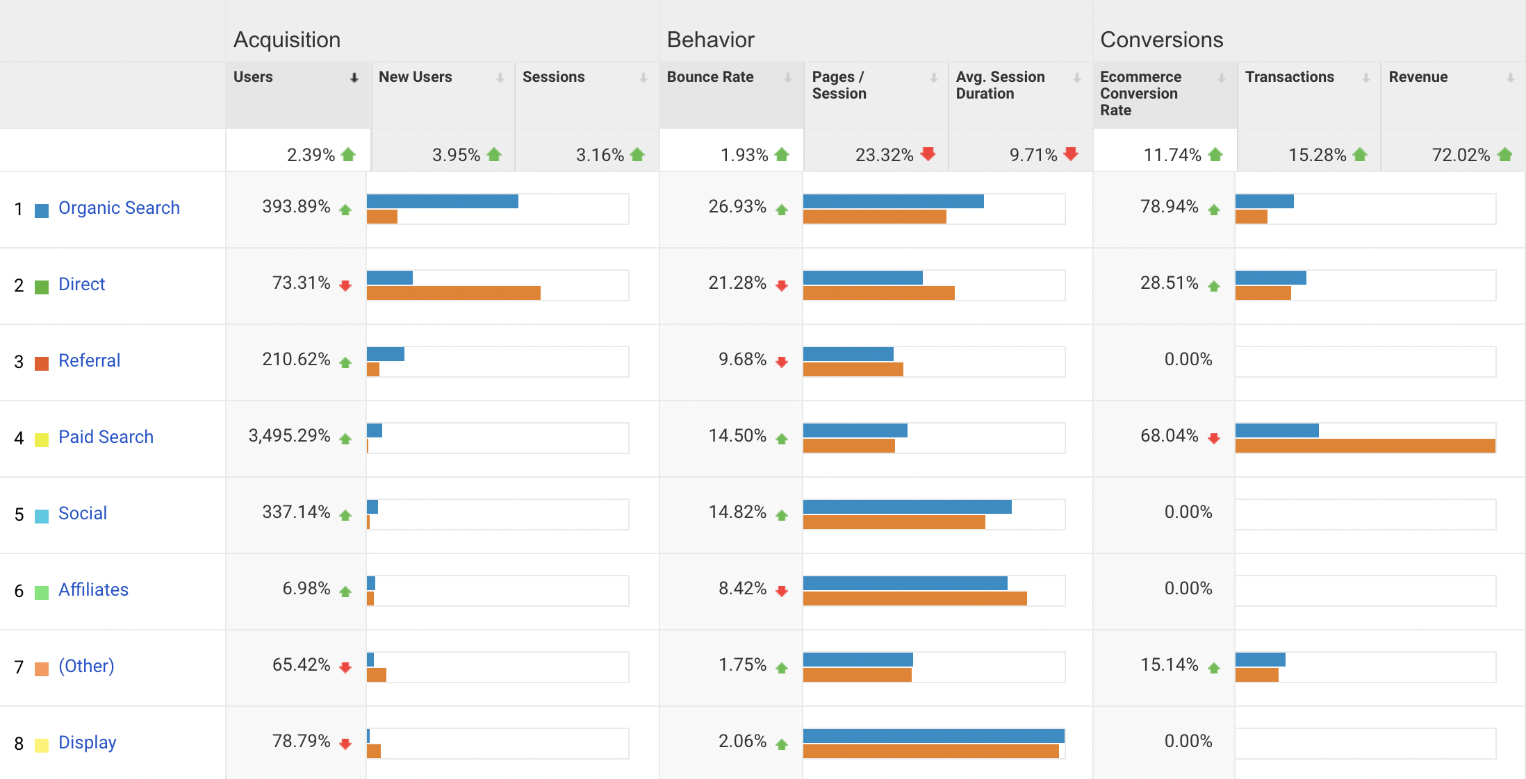
Conversion Rate

Slide 16
OUR RECOMENDATIONS
Refine Keyword Search
Site Optimization
Checkout User Experience
We should add negative keywords to prevent wrong visitors to land on target page, and local keywords which can attract traffic from local people
Refine your ecommerce checkout procedure using A/B testing and provide limited-time coupons by showing pop-ups on our website
Use cart abandonment software to remind customers to checkout. Additionally, By offering free shipping to customers can increase the chances of them buying the product
Notes:
Give an Example

Slide 17
THANKS!

